Slide 1
An overview of UML
Eduardo B. Fernandez
Florida Atlantic University
Boca Raton, FL
http://www.cse.fau.edu/~ed
1

Slide 2
Outline
Background
Model management
Classes and associations
Use cases
Object interaction

Slide 3
Outline (Cont.)
State diagrams
Activity diagrams
Implementation diagrams
Process aspects
Summary

Slide 4
What is UML
UML (Unified Modeling Language) is an object-oriented language for specifying, constructing, visualizing, and documenting a software design.
Basically a notation and its corresponding meaning , not a process.
Developed at Rational by J. Rumbaugh, G. Booch, and I. Jacobson.

Slide 5
Status
Version 1.1, September 1997
Now version 2.0, UML 2.5 was released in October 2012 as an "In process" version and has yet to become formally released.
Contributors : Rational, IBM, HP, MCI, TI, Microsoft, Oracle, I-Logix, ObjecTime,...
Adopted by many companies

Slide 6
More
Adopted by OMG (Object Management Group): http:http://www.uml.org///www.omg.org/uml
Accepted by the International Organization for Standardization (ISO) as industry standard for modeling software-intensive systems.

Slide 7
What is O-O design?
Design based on data together with their operations, not on data transformations
Objects model the aspects of the real world which are of interest in some context
Can be used for designing applications, system programs, hardware, database modeling, web-based systems, XML modeling; that is, almost every kind of software

Slide 8
Some useful links
Patterns: http://www.hillside.net/patterns
OMG UML standard:
http://www.uml.org/
Rational (IBM subsidiary): http://www-
306.ibm.com/software/rational/ (info. on UML
and tools)

Slide 9
UML tools
Purposes:
Diagramming-- creating and editing UML diagrams
Code generation. The UML tool derives from the diagrams part or all of the source code.
Reverse engineering. The UML tool reads program source code as input and derives model data and corresponding graphical UML diagrams from it
Round-trip engineering--the ability of a UML tool to perform code generation from models, and model generation from code (a.k.a., reverse engineering), while keeping both the model and the code semantically consistent with each other.

Slide 10
UML tools available in your cloud desktops
http://en.wikipedia.org/wiki/List_of_UML_tools
Eclipse is an open source community which develops open platforms and products. The community says "[its] projects are focused on building an open development platform consisting of extensible frameworks, tools and runtimes for building, deploying and managing software across the lifecycle“. The Eclipse Foundation is a non-profit corporation which acts as the steward of the Eclipse community.
ArgoUML is an open source UML modeling tool and includes support for all standard UML 1.4 diagrams. It runs on any Java platform and is available in ten languages. http://argouml.tigris.org/

Slide 11
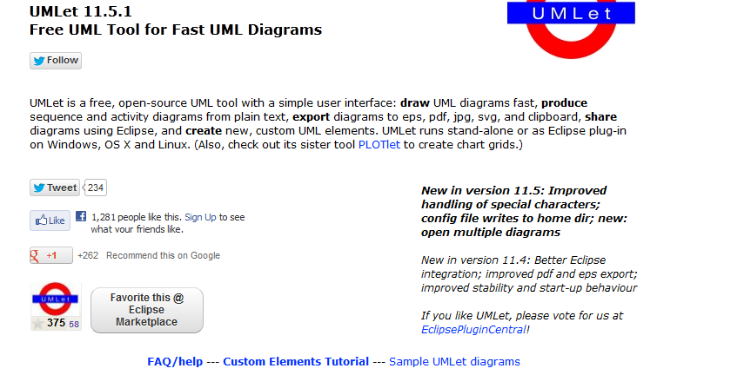
http://www.umlet.com

Slide 12
Gliffy https://www.gliffy.com/uses/uml-software/
Creating a flowchart, uml diagram, org chart, or any other kind of diagram using the Gliffy diagram tool is the first step to turning your idea into a reality.
It is also a great way to get clarity and figure out next steps. Whether you’re an engineer creating a revolutionary piece of software, a manager clarifying roles and responsibilities, or just a person trying to figure out the complex relationship between ninjas, pirates and zombies, Gliffy diagram software has all the tools you need to get started.

Slide 13
Value of precise modeling
Fundamental to build complex systems. These cannot be understood or built correctly without a conceptual model
Semiformal approach -- intuitive
Useful for development and documentation

Slide 14
Diagrams
Use case -- requirements
Class -- static or data model
Behavior -- state, activity, sequence, collaboration (dynamic aspects)
Implementation -- component, deployment
Different views of a system

Slide 15
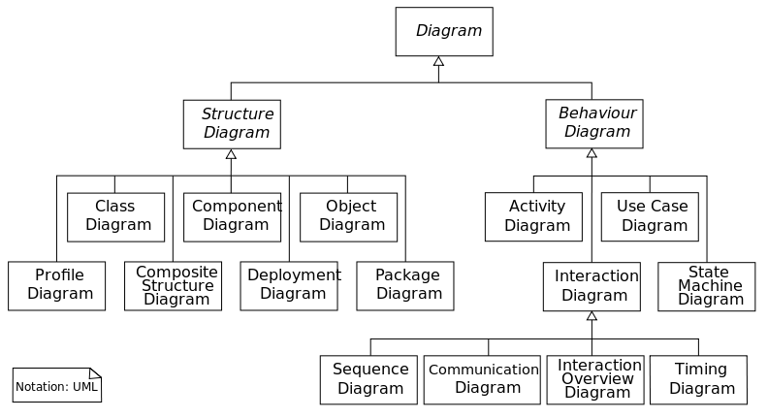
14 diagrams

Slide 16
OOA lifecycle
Requirements : Use cases
Analysis : class diagrams, state diagrams, sequence diagrams
Design : refined class diagrams, collaboration diagrams, operation descriptions, class contracts, patterns
Implementation : component and deployment diagrams

Slide 17
Packages
A grouping of model elements for model management and organization
Packages own elements
Elements are other packages or classes
Basis for configuration control, storage, and access control
Useful to delimit work scope

Slide 18
Example of a package
<<subsystem>>
Editor
Controller
Data
Elements
Domain
Elements
Graphics
Core
Windowing
System
MotifCore
Motif
Windows
Core
Microsoft
Windows

Slide 19
Manufacturing system
Customer_Orders
Shop_
Orders
Manu-facturing
Inventory
Components
Shipping

Slide 20
Stereotypes
A stereotype is a new class of modeling element introduced at modeling time
A subclass of an existing model element with the same form but different intent
Built-in extensibility mechanism for UML

Slide 21
Example of stereotypes
<<control>>
PenTracker
<<control>>
PenTracker
location: Point
location: Point
enable (Mode)
enable (Mode)
PenTracker
location: Point
enable (Mode)

Slide 22
Static model
Classes
Associations between classes
Objects
Operations
Attributes
Parameter types

Slide 23
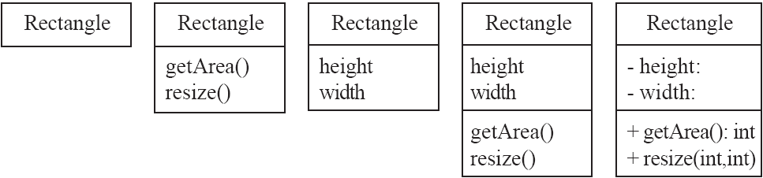
Classes
A class is simply represented as a box with the name of the class inside
  The diagram may also show the attributes and operations
  The complete signature of an operation is:
    operationName(parameterName: parameterType …): returnType

Slide 24
Class notation
Window
Window
{abstract,
author=Joe,
status=tested}
+size:Area = (100,100)
#visibility: Boolean = invisible
+default-size: Rectangle
#maximum-size:Rectangle
-xptr: XWindow*
Window
size: Area
visibility:Boolean
+display()
+hide()
+create()
-attachXWindow(xwin:Xwindow*)
display()
hide()

Slide 25
Classes and objects
p1:Point
Point
x=3.14
y=2.718
x:Real
y:Real
rotate(angle:Real)
scale(factor:Real)
:Point
x=1
y=1.414

Slide 26
Generalization
Customer
name
address
creditRating():String
CorporateCustomer
PersonalCustomer
contactName
creditRating
creditLimit
creditCard#
remind()
billForMonth(Integer)
{creditRating() == “poor”}

Slide 27
Associations
Collaboration of two (or more) classes to define a meaningful fact
Associations have multiplicities (one to one, one to many, many to many), and direction
Analysis associations are usually bidirectional

Slide 28
Association example
Order
Customer
dateReceived
isPrepaid
number : String
price:Money
*
1
name
address
dispatch()
close()
Navigability
creditRating():String

Slide 29
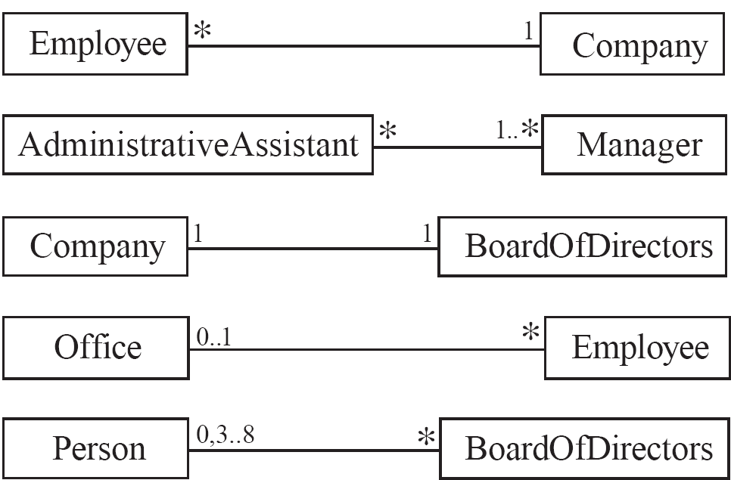
5.3 Associations and Multiplicity
An association is used to show how two classes are related to each other
  Symbols indicating multiplicity are shown at each end of the association

Slide 30
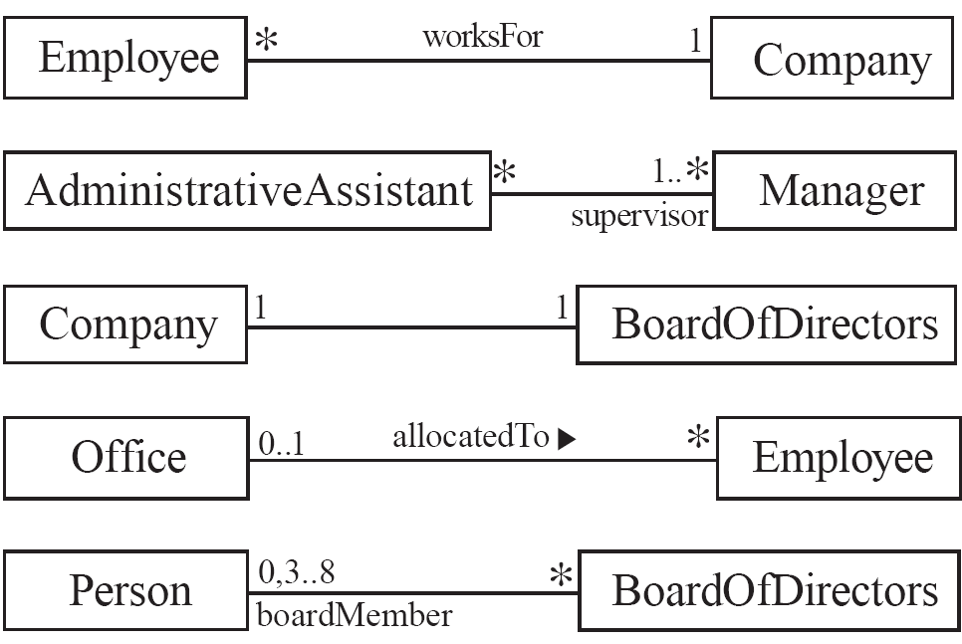
Labelling associations
  Each association can be labelled, to make explicit the nature of the association

Slide 31
Constraints
*
Member-of
*
Person
{subset}
Committee
Represents
an incorporated entity
1
Chair-of
*
worker
employee
employer
*
Person
*
0..1
Company
0..1
boss
{Person.employer =
Person.boss.employer}

Slide 32
Association class
*
Job
1..*
Company
Person
employer
employee
Job
salary
boss
0..1
worker
*
Manages

Slide 33
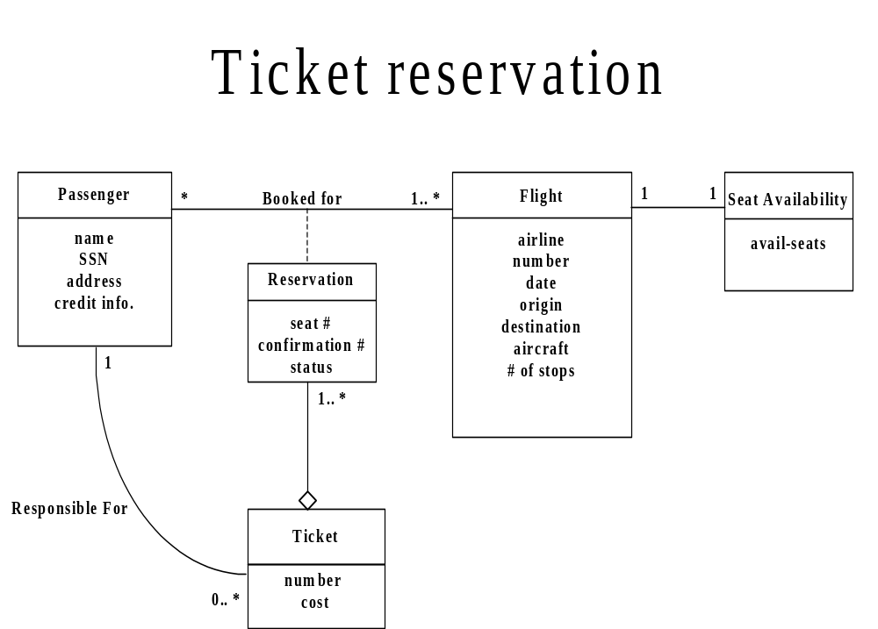

Slide 34
Composition/aggregation
Window
scrollbar [2]:Slider
title: Header
body: Panel
Window
1
1
1
scrollbar
2
title
1
body
1
Slider
Header
Panel

Slide 35
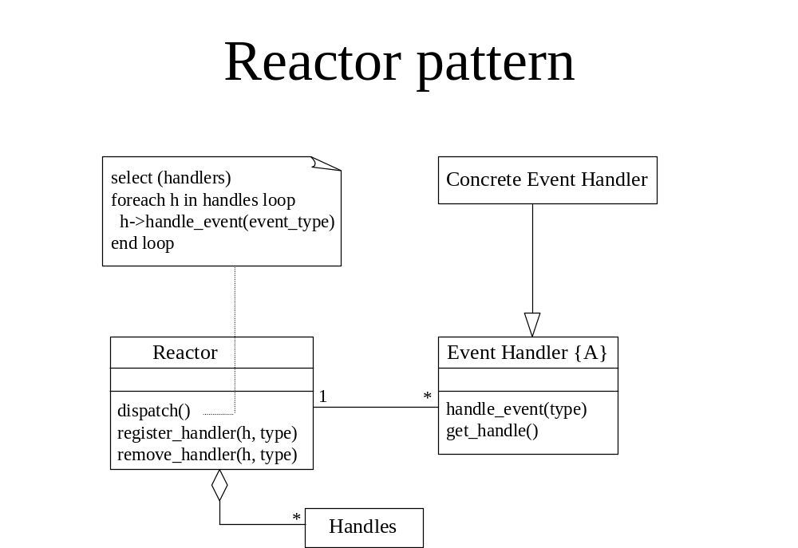

Slide 36
Orders model
Order
dateReceived
isPrepaid
number : String
price : Money
Customer
*
1
name
address
creditRating():String
dispatch()
close()
Navigability
1
Corporate
Customer
Personal
Customer
{if Order.customer.creditRating is
“poor” then Order.isPrepaid
must be true}
creditCard#
contactName
creditRating
creditLimit
{creditRating() == “poor”}
remind
billForMonth(Integer)
*
OrderLine
*
quantity : Integer
price : Money
isSatisfied:Boolean
sales rep
0..1
*
1
Product
Employee

Slide 37
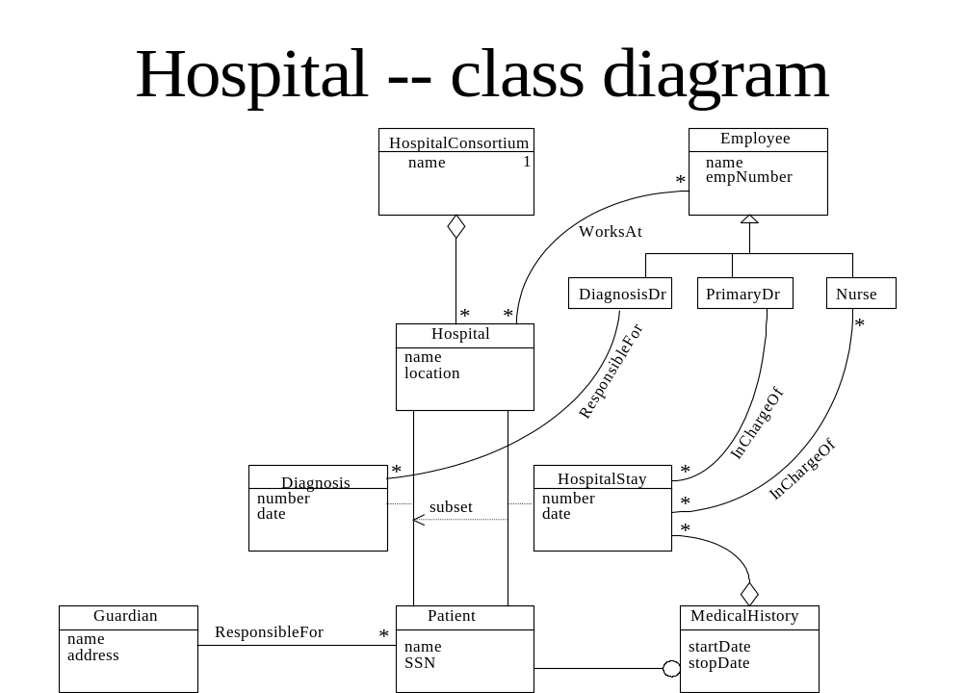

Slide 38
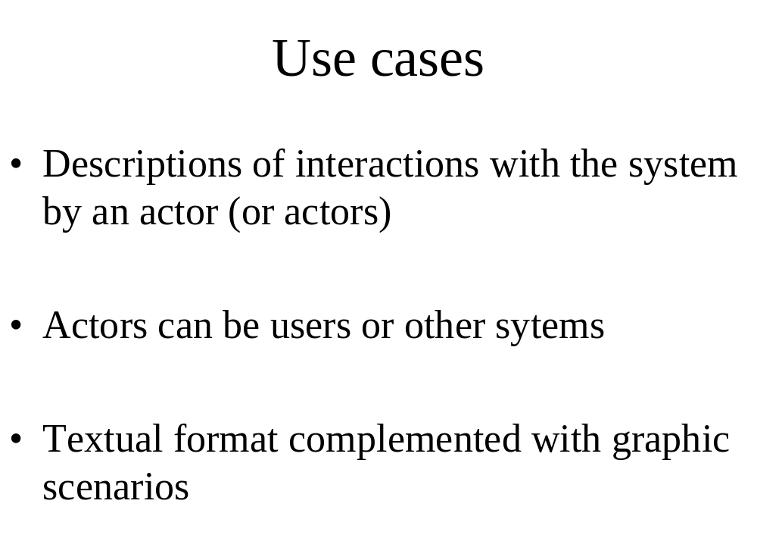

Slide 39
How to describe a single use case
A. Name: Give a short, descriptive name to the use case.
B. Actors: List the actors who can perform this use case.
C. Goals: Explain what the actor or actors are trying to achieve.
D. Preconditions: State of the system before the use case.
E. Summary: Give a short informal description.
F. Related use cases.
G. Steps: Describe each step using a 2-column format.
H. Postconditions: State of the system in following completion.
A and G are the most important

Slide 40
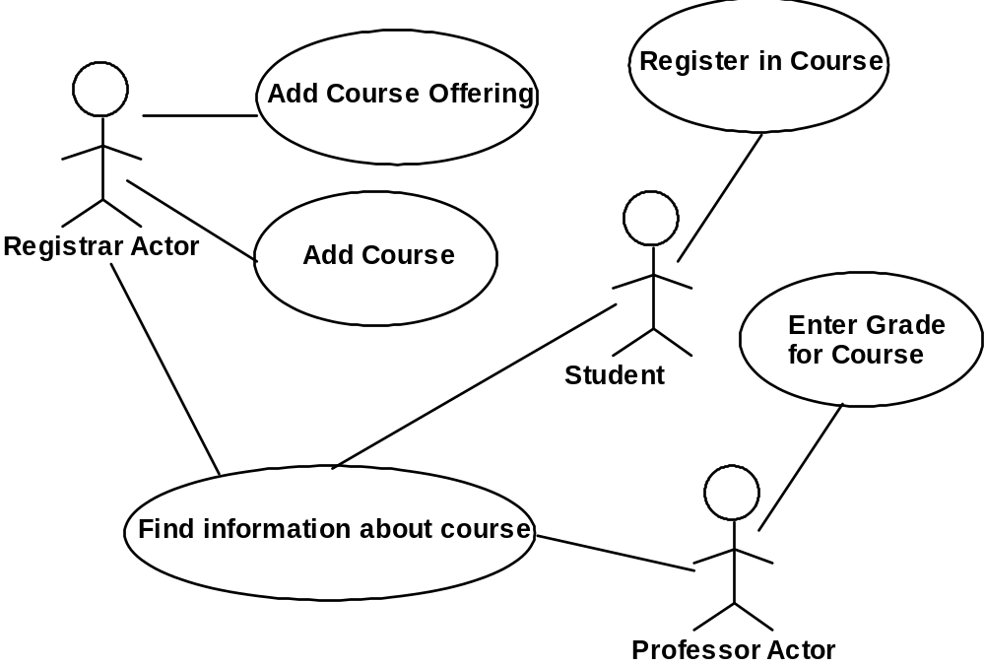
Use case diagrams

Slide 41
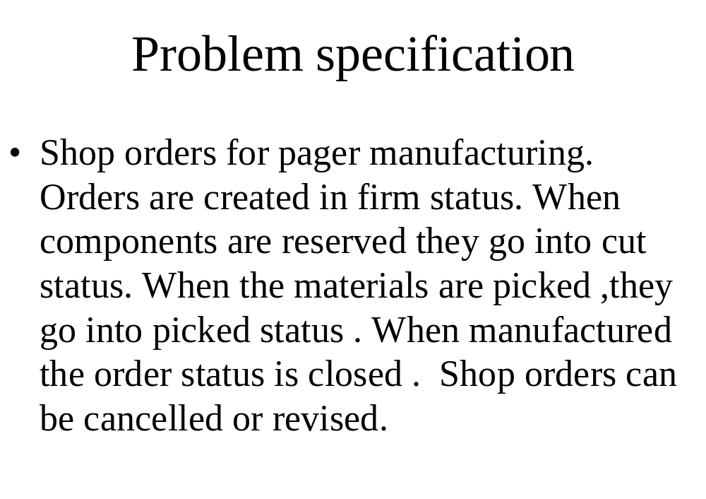

Slide 42
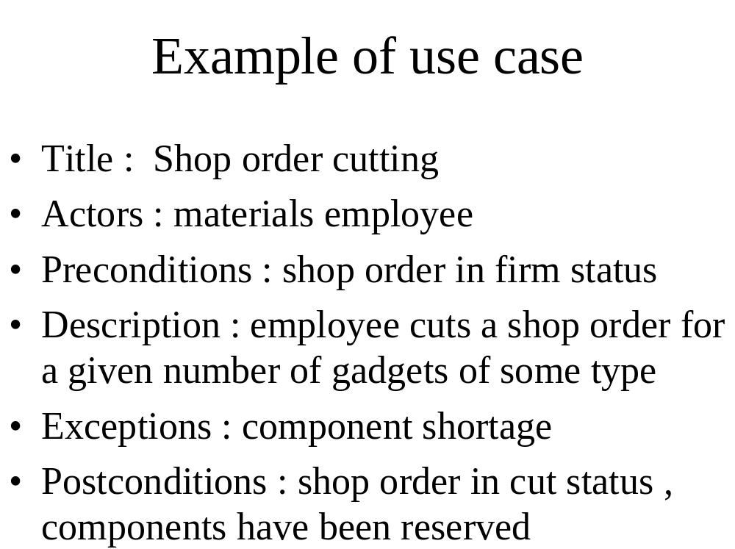

Slide 43
Use case diagram
Telephone Catalog
check
status
Salesperson
place
order
Shipping Clerk
Customer
fill
orders
establish
credit
Supervisor

Slide 44
Sequence diagrams
A type of Object Interaction diagram
Description of scenarios or event trace
Several sequence diagrams describe a use case
One sequence diagram for normal scenario and several for exceptional conditions

Slide 45
Sequence diagram
caller
exchange
receiver
a
lift receiver
{b-a < 1 sec.}
b
dial tone
{c - b < 10 sec.}
dial digit
c
...
The call is
routed through
the network
d
route
d’
phone rings
{d’ - d < 5 sec.}
ringing tone
answer phone
At this point
the parties
can talk
stop tone
stop ringing

Slide 46
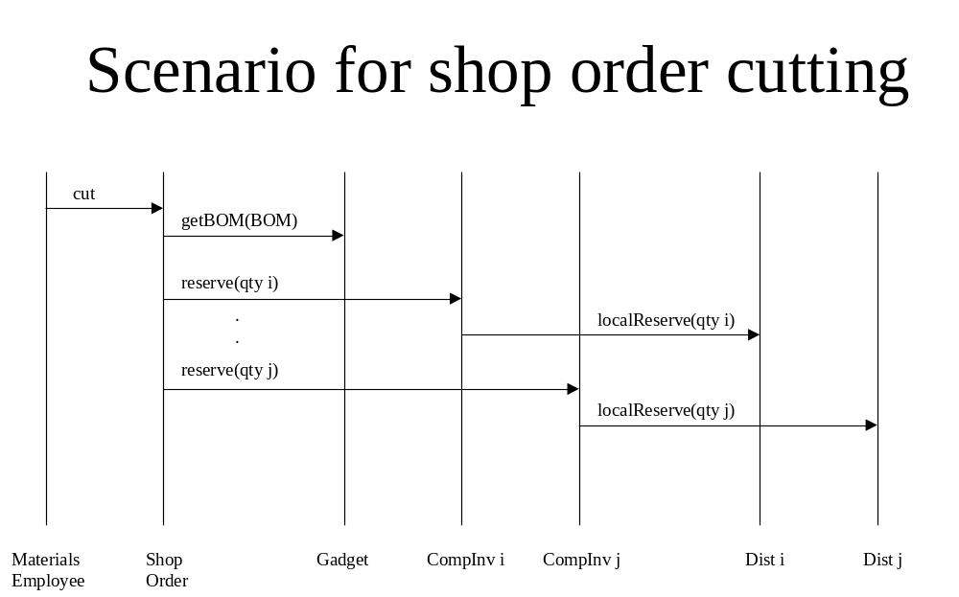

Slide 47
Sequence diagram with control
ob3:C3
ob4:C4
op()
ob1:C1
[x>0] foo(x)
ob2:C2
[x<0] bar(x)
doit(z)
doit(w)
more()

Slide 48
Collaboration diagram
:Order Entry Window
1: prepare()
Sequence Number
:Order
1.1.2.1:needToReorder
1.1*: prepare()
1.1.1 check()
1.1.2 [check==true] remove()
Macallan:Order Line
Macallan stock:Stock Item
1.1.3: [check == true] new
1.1.2.2: new
:Delivery Item
:Reorder Item

Slide 49
State
Typing Password
entry / set echo invisible
exit / set echo normal
character / handle character
help / display help

Slide 50
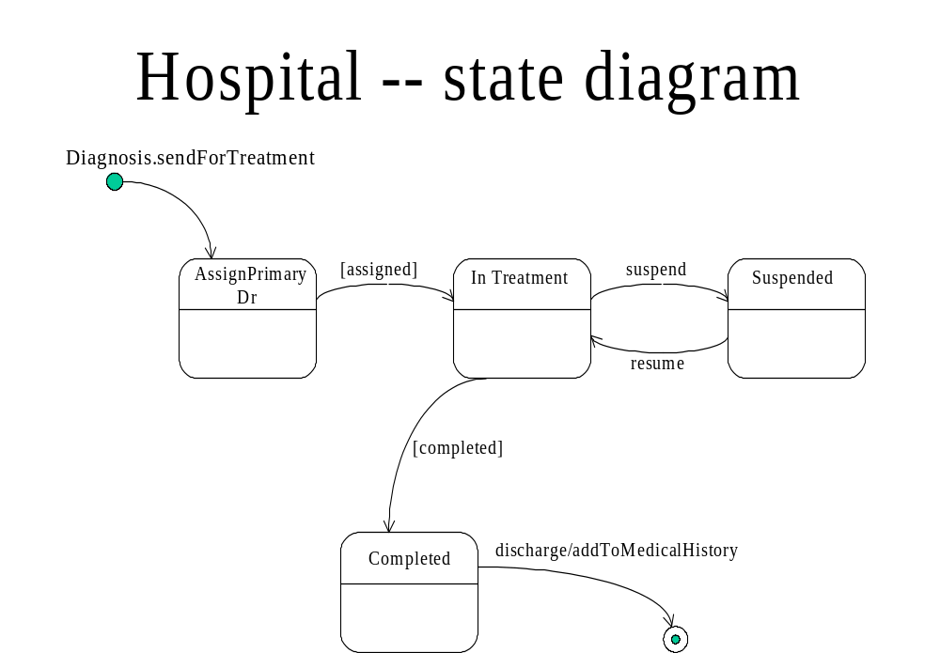

Slide 51
Activity diagram
Receive
Order
Multiple Trigger
for each line item on order
*
Cancel
Order
Authorize
Payment
Check
Line Item
[failed]
[succeeded]
[in stock]
Assign to
Order
Synchronization Condition
[need to
reorder]
[stock assigned to
all line items and
payment authorized]
Reorder
Item
Dispatch
Order

Slide 52
Deployment diagram
AdminServer:HostMachine
<database>>
:meetingsDB
:Scheduler
reservations
Joe’sMachine:PC
:Planner

Slide 53
Components
spell-check
Dictionary
synonyms
mymailer:Mailer
RoutingList
Mailbox

Slide 54
Summary
UML is a good notation and becoming the accepted standard
Not useful without knowledge of OO concepts
Use of patterns is important for model understanding and reusability
A good tool is important

Slide 55
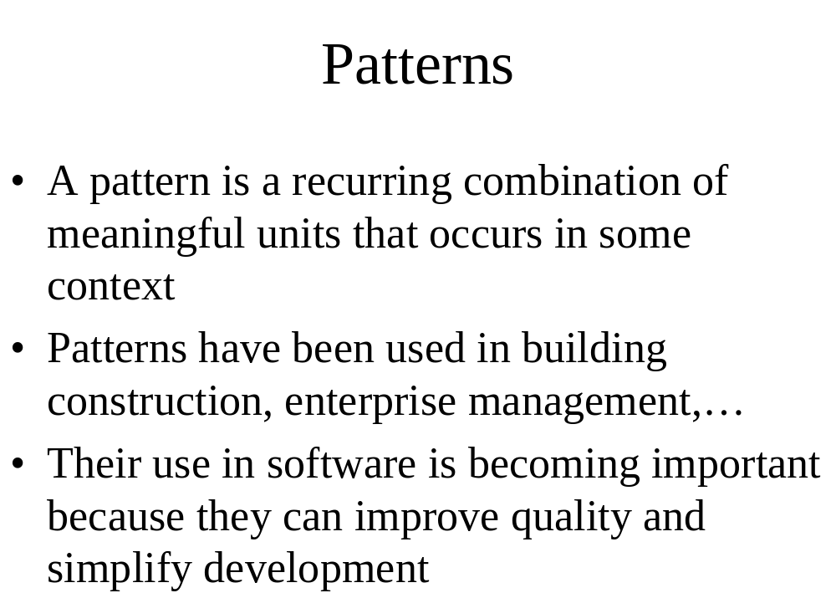

Slide 56
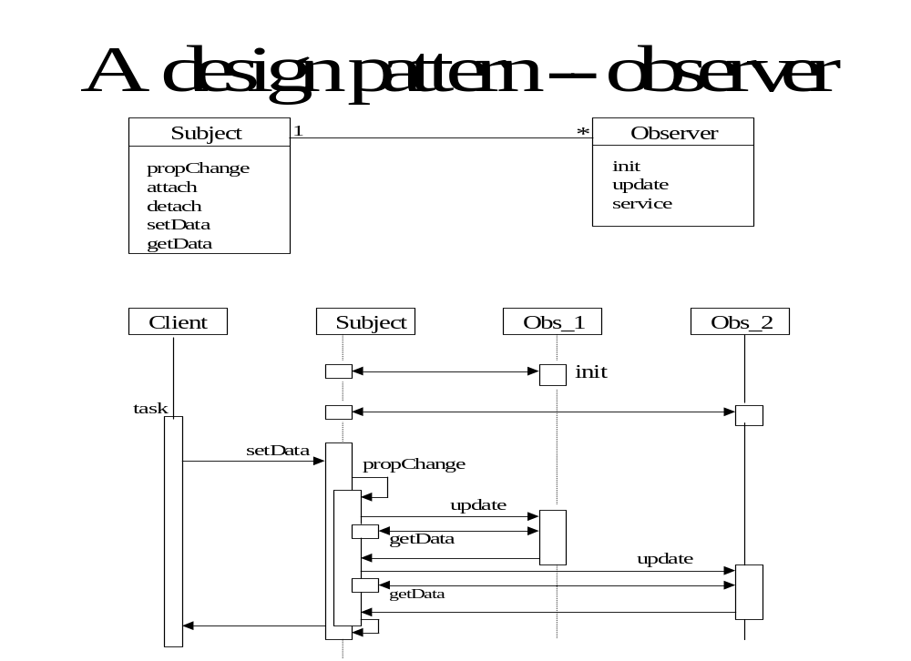

Slide 57
An architectural pattern: Broker
The Broker structures distributed systems with separate components that interact by remote service calls. A broker coordinates communications, including forwarding requests and sending back results and exceptions.
Forces
Components should be able to access remote services in a location-transparent way.
Components may need to be exchanged, added, or removed at execution time.
Implementation details should be hidden from the users of components and services.

Slide 58
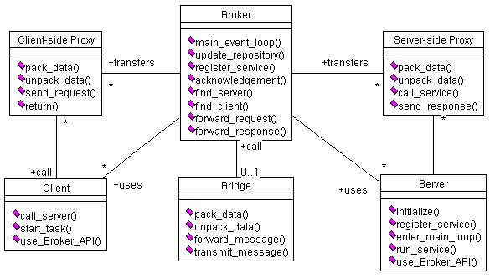
Class diagram of Broker

Slide 59
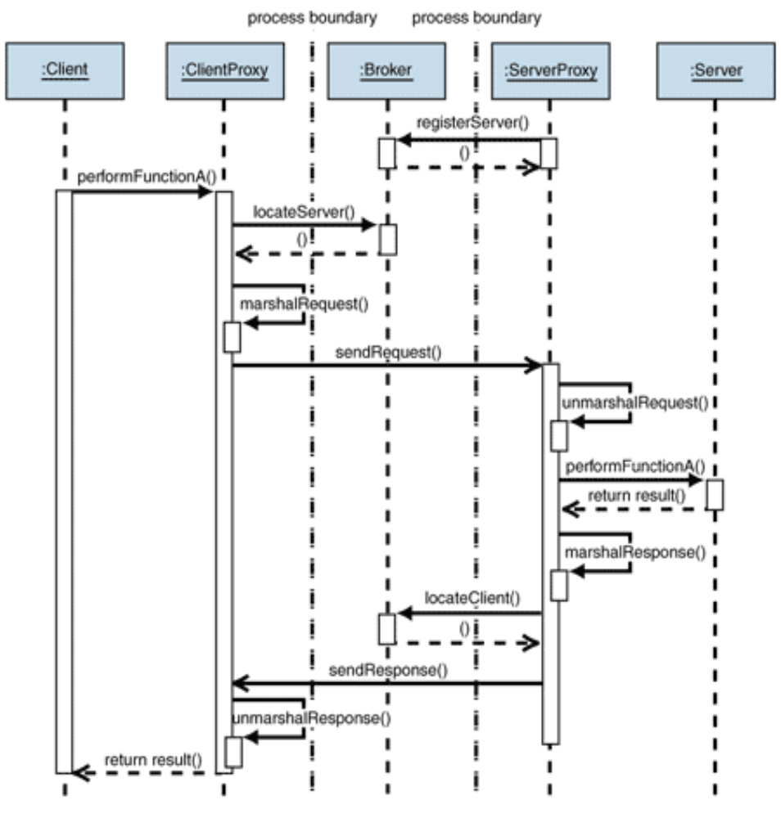
UCs: Register and Request Service

Slide 60
Known uses
CORBA
IBM’s SOM/DSOM
Microsoft’s DCOM, .NET Remoting
Sun’s RMI
This pattern (and the Layers and Lookup patterns) are used in the Bluetooth specification

Slide 61
Consequences
Advantagess
Remote objects or units can be accessed transparently, as if they were local
Changeability and extensibility of components
Interoperability between different Broker systems
Portability of a broker system because low level details are hidden from users
Reusability
Liabilities
Error handling
Lower fault tolerance
Restricted efficiency
Testing and debugging

Slide 62
Consequences
Advantagess
Remote objects or units can be accessed transparently, as if they were local
Changeability and extensibility of components
Interoperability between different Broker systems
Portability of a broker system because low level details are hidden from users
Reusability
Liabilities
Error handling
Lower fault tolerance
Restricted efficiency
Testing and debugging

Slide 63
Process approach
Incremental -- Implement a few use cases at a time
Iterative -- Parts of analysis, design, or implementation may be repeated

